Slide 1
Visual Analytics with Tableau
View Data Visualization with Tableau course details at www.edureka.co/data-visualization-with-tableau
For Queries:
Post on Twitter @edurekaIN: #askEdureka
Post on Facebook /edurekaIN
For more details please contact us:
US : 1800 275 9730 (toll free)
INDIA : +91 88808 62004
Email Us : sales@edureka.co

Slide 2
Objectives
At the end of this session, you will be able to:
Direct connection with Statistical packages
Splitting data columns
All new Tableau Discover Side Menu
Connecting to Data Source
Dynamically Fast Tool Tip

Slide 3
Connecting With Statistical Packages
The new connector in Tableau 9.x brings native support for a number of statistical package files including:
.sas7bdat – the file format used by SAS
.sav – the binary file format used by SPSS
.rdata, .rda – the file formats employed by the R statistical analysis package

Slide 4
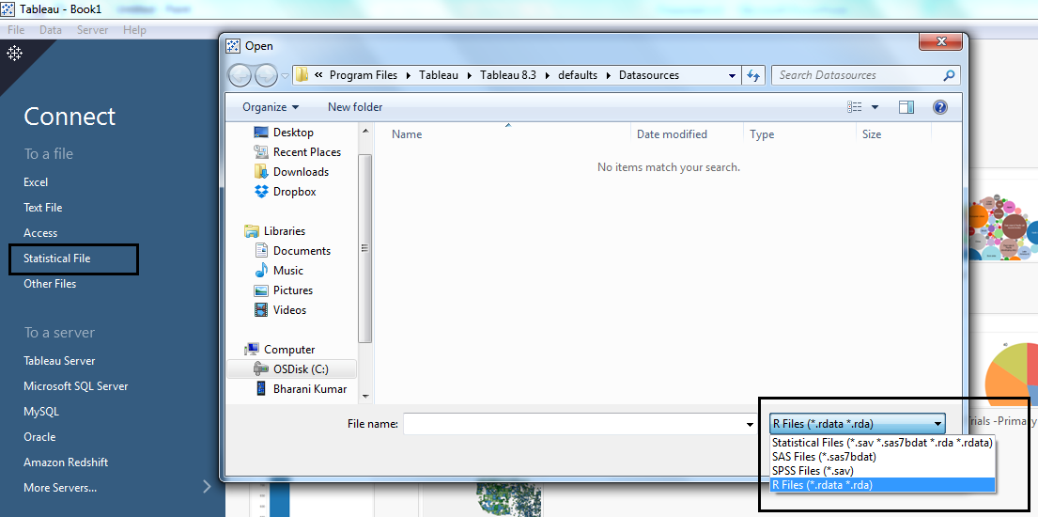
Connecting With Statistical Packages

Slide 5
Splitting Data Columns
If you have string fields in your data that contain multiple units of information, it might be easier to analyze the data if you split the values in that field into separate fields.
For example, the first and last name of a customer
You can use split or custom split options in Tableau to separate the values based on a separator or a repeated pattern of values present in each row of the field.
Just right-click on the dimension you want to split, navigate to the new ‘Transform’ menu and click Split.
Tableau will automatically try to figure out the delimiter and split the data accordingly, but you can also choose Custom Split and specify the delimiter yourself if you like.

Slide 6
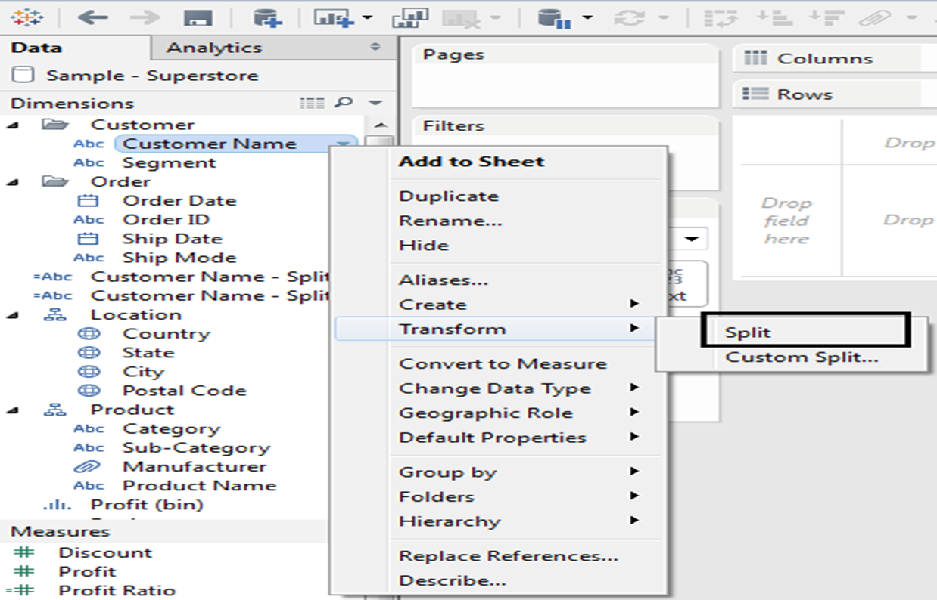
Splitting Data Columns

Slide 7
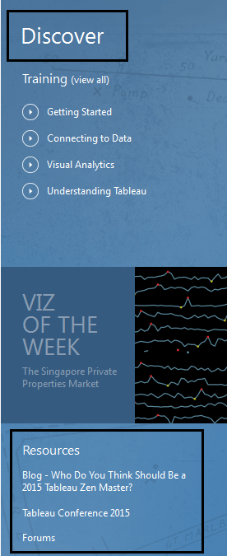
Tableau Discover Side Menu
When you open Tableau v9 for the first time you’ll now notice a new menu on the right that alerts you to a bunch of handy Tableau resources, including links to training for beginners , resources ( blogs ) etc.

Slide 8
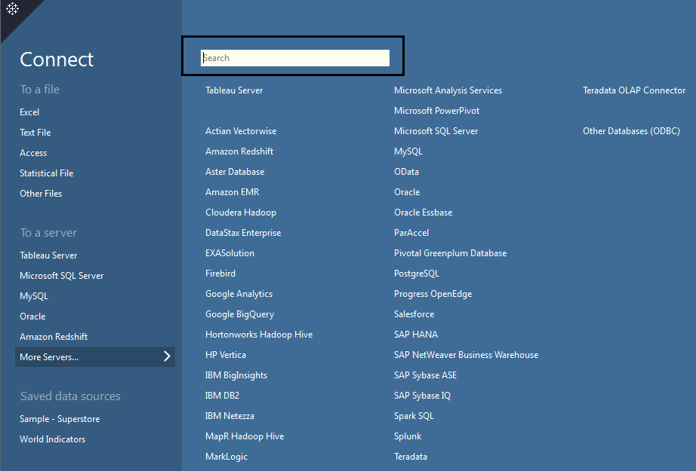
Connecting to Data Source
The search option now gives drop-down menu, which allows you to really quickly connect to a new data source,
without having to navigate to another page.

Slide 9
Top Tip Which is Lightening Fast
In current versions of Tableau, a tooltip only stays alive for 8 seconds and then it disappears.
Now in Tableau v9, tooltips stick around for as long as you leave your mouse in place.
Furthermore, tooltips are now super responsive, populating with new data for whichever mark you’re hovering over in real-time. You can disable it as well using tooltip window

Slide 10
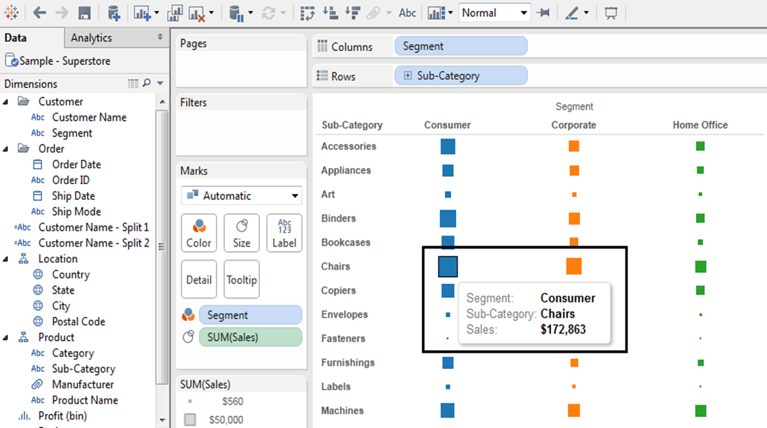
Top Tip Which is Lightening Fast

